Slide 1
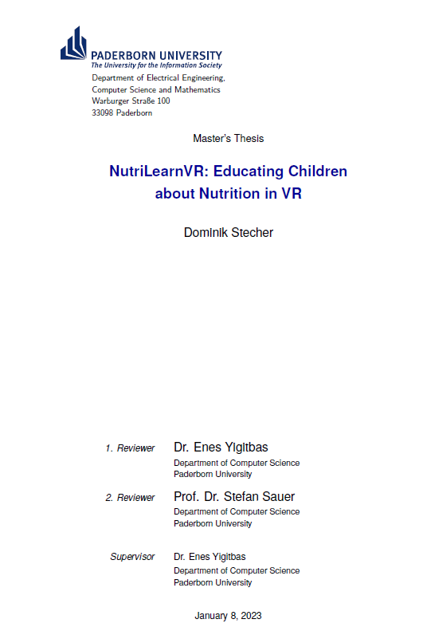
NutriLearnVR: Educating Children about Nutrition in VR
Master‘s Thesis Defense
Dominik Stecher
18.01.2024
Notes:
Introduction..
Master’s thesis deals, among others, with the topic of nutrition, which typically accompanies us on a daily basis. The human body: resilient and, depending on the source, can cope without food for ~2 weeks until immune system is weakened to a level that is dangerous to health.
We can survive without food up to 3 months. Nevertheless, science often speaks of a global obesity epidemic, especially at a young age.

Slide 2
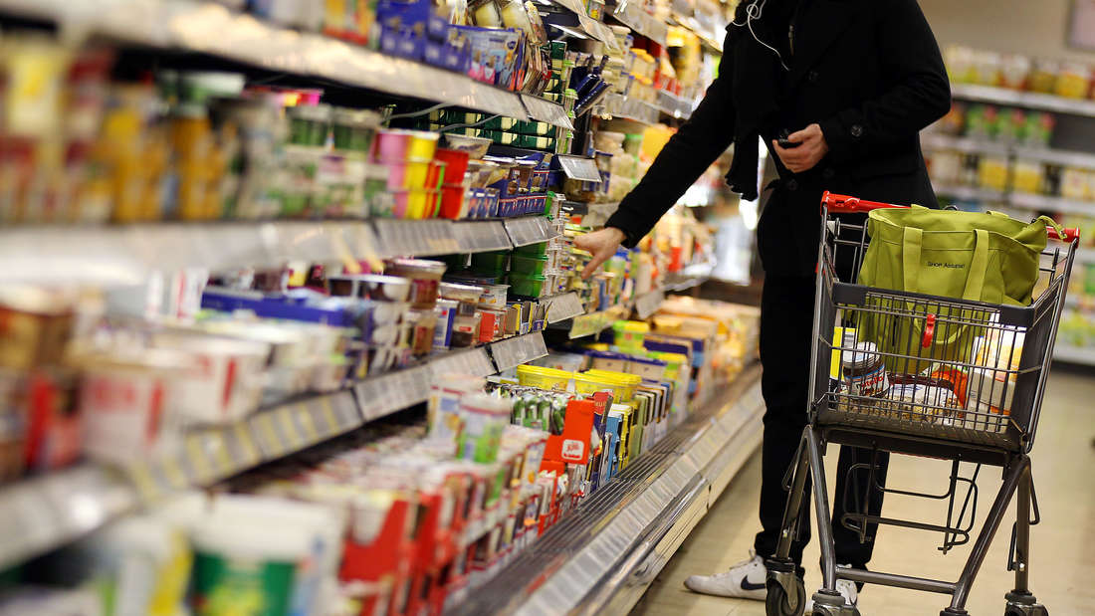
Introduction
Source: hna.de [1]
Notes:
An important reason for the development of this obesity is the huge selection of foods in our supermarkets and the large proportion of foods to which sugar and fats are added. The temptation to eat unhealthy, artificially sweetened foods is generally too high. In addition, our understanding of food and its composition as well as a fundamentally healthy diet has decreased over the years, possibly because the relevant content is not taught properly.
NutriLearnVR mainly targets younger generation to counteract this trend and provide further long-term benefits to health, potentially on global level.

Slide 3
Introduction
Nutrition
Food Compositions
Macronutrients
Micronutrients (Vitamins, Minerals, …)
Education complex
Intolerances
Preferences
Body Compositions
Notes:
Nutrition itself is complex due to complexity of food compositions.
Education brings further challenges

Slide 4
Introduction
Nutrition
Food Compositions
Macronutrients
Micronutrients (Vitamins, Minerals, …)
Education complex
Intolerances
Preferences
Body Compositions
VR Systems
„New“ Trend
More Relevance (Metaverse)
Revolutionize Education
User Engagement
Gamification
Notes:
VR Systems on the other hand provide new ways of interaction, especially with younger generation
Capability to revolutionlize education

Slide 5
Introduction
Nutrition
Food Compositions
Macronutrients
Micronutrients (Vitamins, Minerals, …)
Education complex
Intolerances
Preferences
Body Compositions
VR Systems
„New“ Trend
More Relevance (Metaverse)
Revolutionize Education
User Engagement
Gamification
1 Food Education VR App in Meta Store (2019) [2]
Notes:
Merging both areas is complex goal but helpful, since…

Slide 6
NutriLearnVR
Notes:
But if we now take our VR headset, in which case Meta Quest devices were used for development…

Slide 7
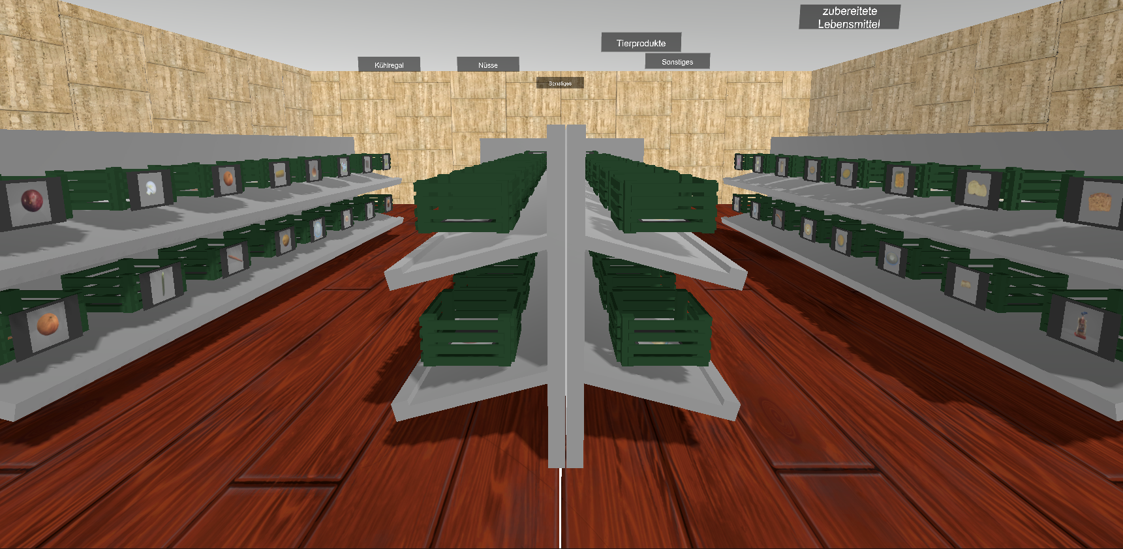
NutriLearnVR
Notes:
… apply a learning environment in sandbox style to make users interact with food products of different categories from their everyday life…

Slide 8
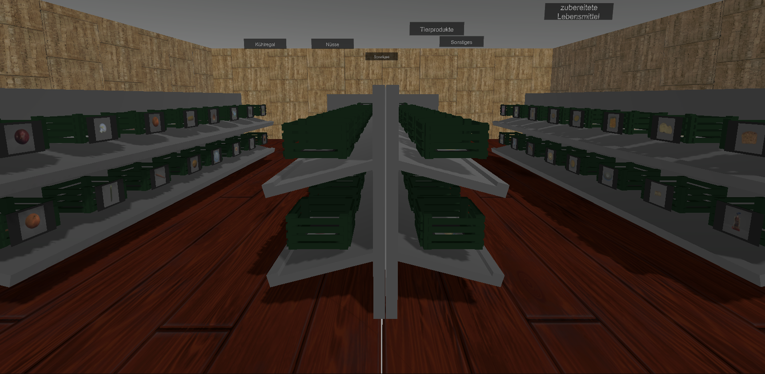
NutriLearnVR
Nutri
Learn
Notes:
… we get out NutriLearn VR Application.
Trying to address food selections in everyday life, influencing choices for a long-term better health
(5)

Slide 9
Healthy Diet Definition - Simplified
Professional Consultation:
Fruits & Vegetables: 5+ Portions [3]
Nuts: at least 1 Portion [3]
Whole Grain Products: 2+ Products [4]
Dairy Products: 2+ Products [5]
„Good“ average Nutri-Score [6]
Other Factors (Nutrient Quality)
Notes:
Definition based on Professional Consultation with Public Health Department Head Prof. Buyken at Paderborn University.
Mainly based on picking from categories as recommended by German Nutrition Society, refined with supplementary sources and taking nutrient quality into account

Slide 10
System Expectations – 8 Criteria
(C1) Build a suitable VR Application
(C2) Display Food Products in different Categories
(C3) Use Macronutrient Information for displayed Products
(C4) Make individual Computations for current User
(C5) Make Information to convey more understandable
(C6) Support different Individual Scenes
(C7) Assess Learning Effects from using Software
(C8) Assess Usability of Software
Notes:
8 Criteria defined for analyzing & comparing related work
Requirements for own Application Development

Slide 11
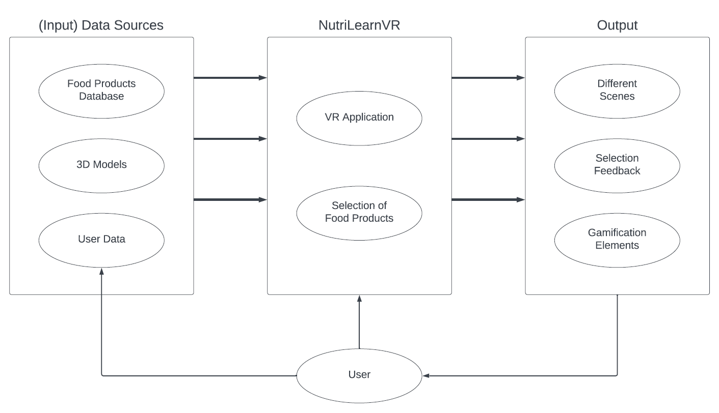
Solution Concept
Notes:
Divided into 3 Parts: User mainly interacts with Application by selecting food products; 3D representation of database. Also inputs user data for individualization purposes.
The application provides different scenes to try addressing different scenarios from everyday life, giving feedback to influence selection and adding gamification elements to provide motivation

Slide 12
Solution Concept
Approx. 250 entries [10]
Notes:
Database is based on Swiss Food Composition Database
Some details removed, other information like relevant categories added. Nutri-Score added. Currently contains ~250 entries.
(8-9)

Slide 13
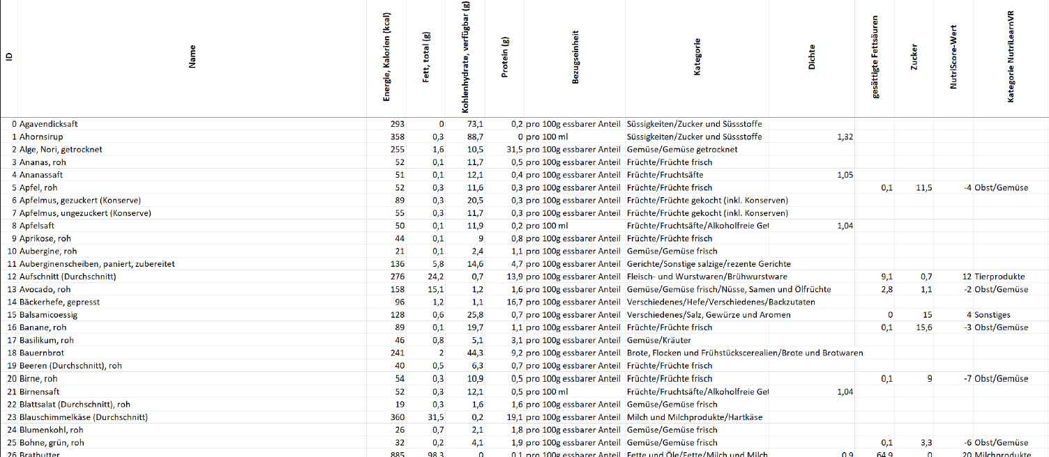
Database Excerpt
Notes:
Database excerpt showing stored information about products

Slide 14
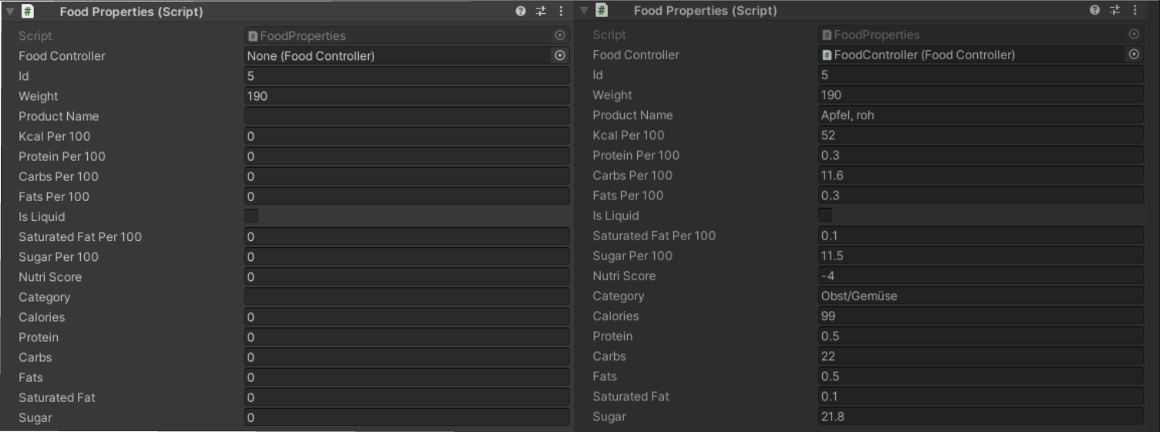
Food Properties
Notes:
Information stored in Food Properties automatically
Only ID & Portion Size have to be entered manually!

Slide 15
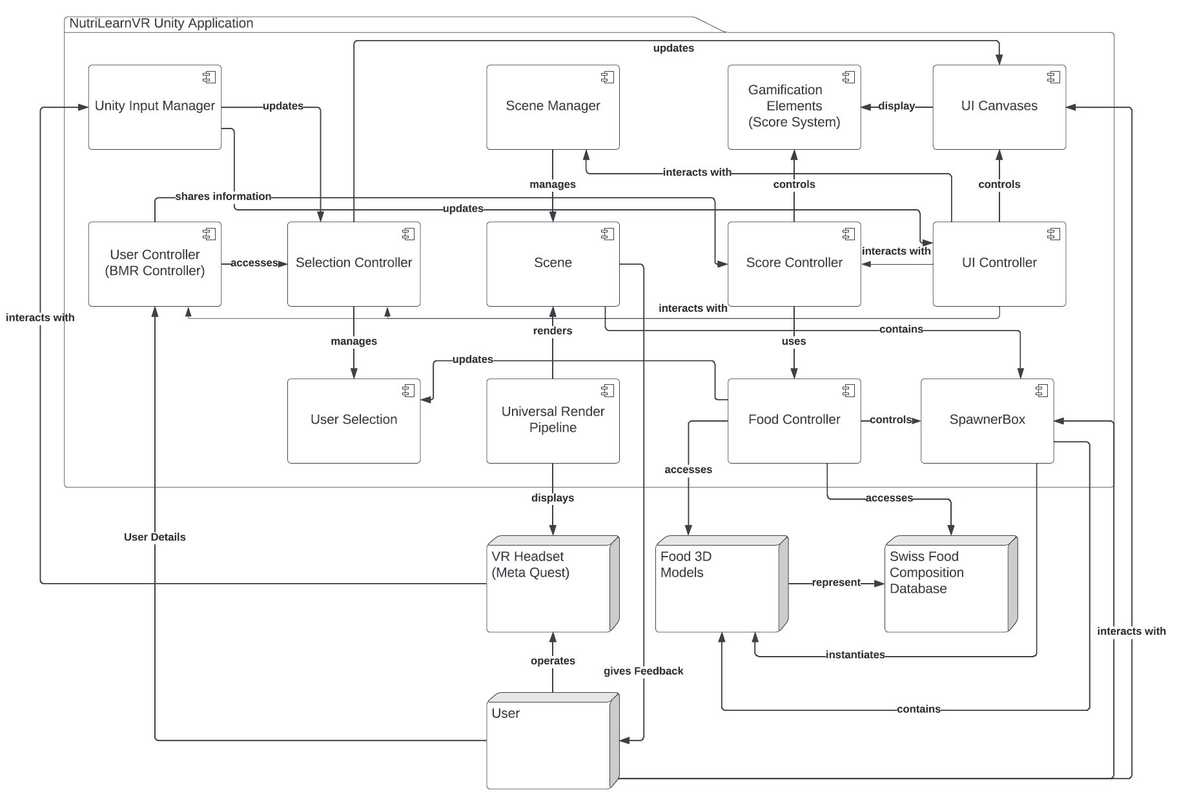
System Architecture
Notes:
User operates headset, which interacts with Unity Input Manager. Also provides personal information in User Controller for individualization.
Headset displays Scene from Scene Manager, which contains SpawnerBoxes. SpawnerBoxes contain 3D representations of database, managed by Food Controller.
Food Controller updates User Selection of selectable food products.
Score & UI Elements (Coloring) implemented for Gamification, accessing information about user and selection and displaying within UI again.
Model-View-Controller Pattern → Vertical Representation → Model: Controller classes (managing application logic, determine information to be displayed); View: Immersiveness of VR Application, 3D Models, UI Elements; Controller: Unity Input System (processes user inputs into Unity events to trigger listeners in Model Controllers and computing/displaying information in View), but no 1:1 correspondence.
Besides Gang of Four: Update Pattern in Unity (MonoBehavior), Prototype Pattern (Prefabs), Component Design Pattern (Objects consist of components allowing individual, small, specific component classes)

Slide 16
Visual Introduction
Notes:
Play Video here

Slide 17
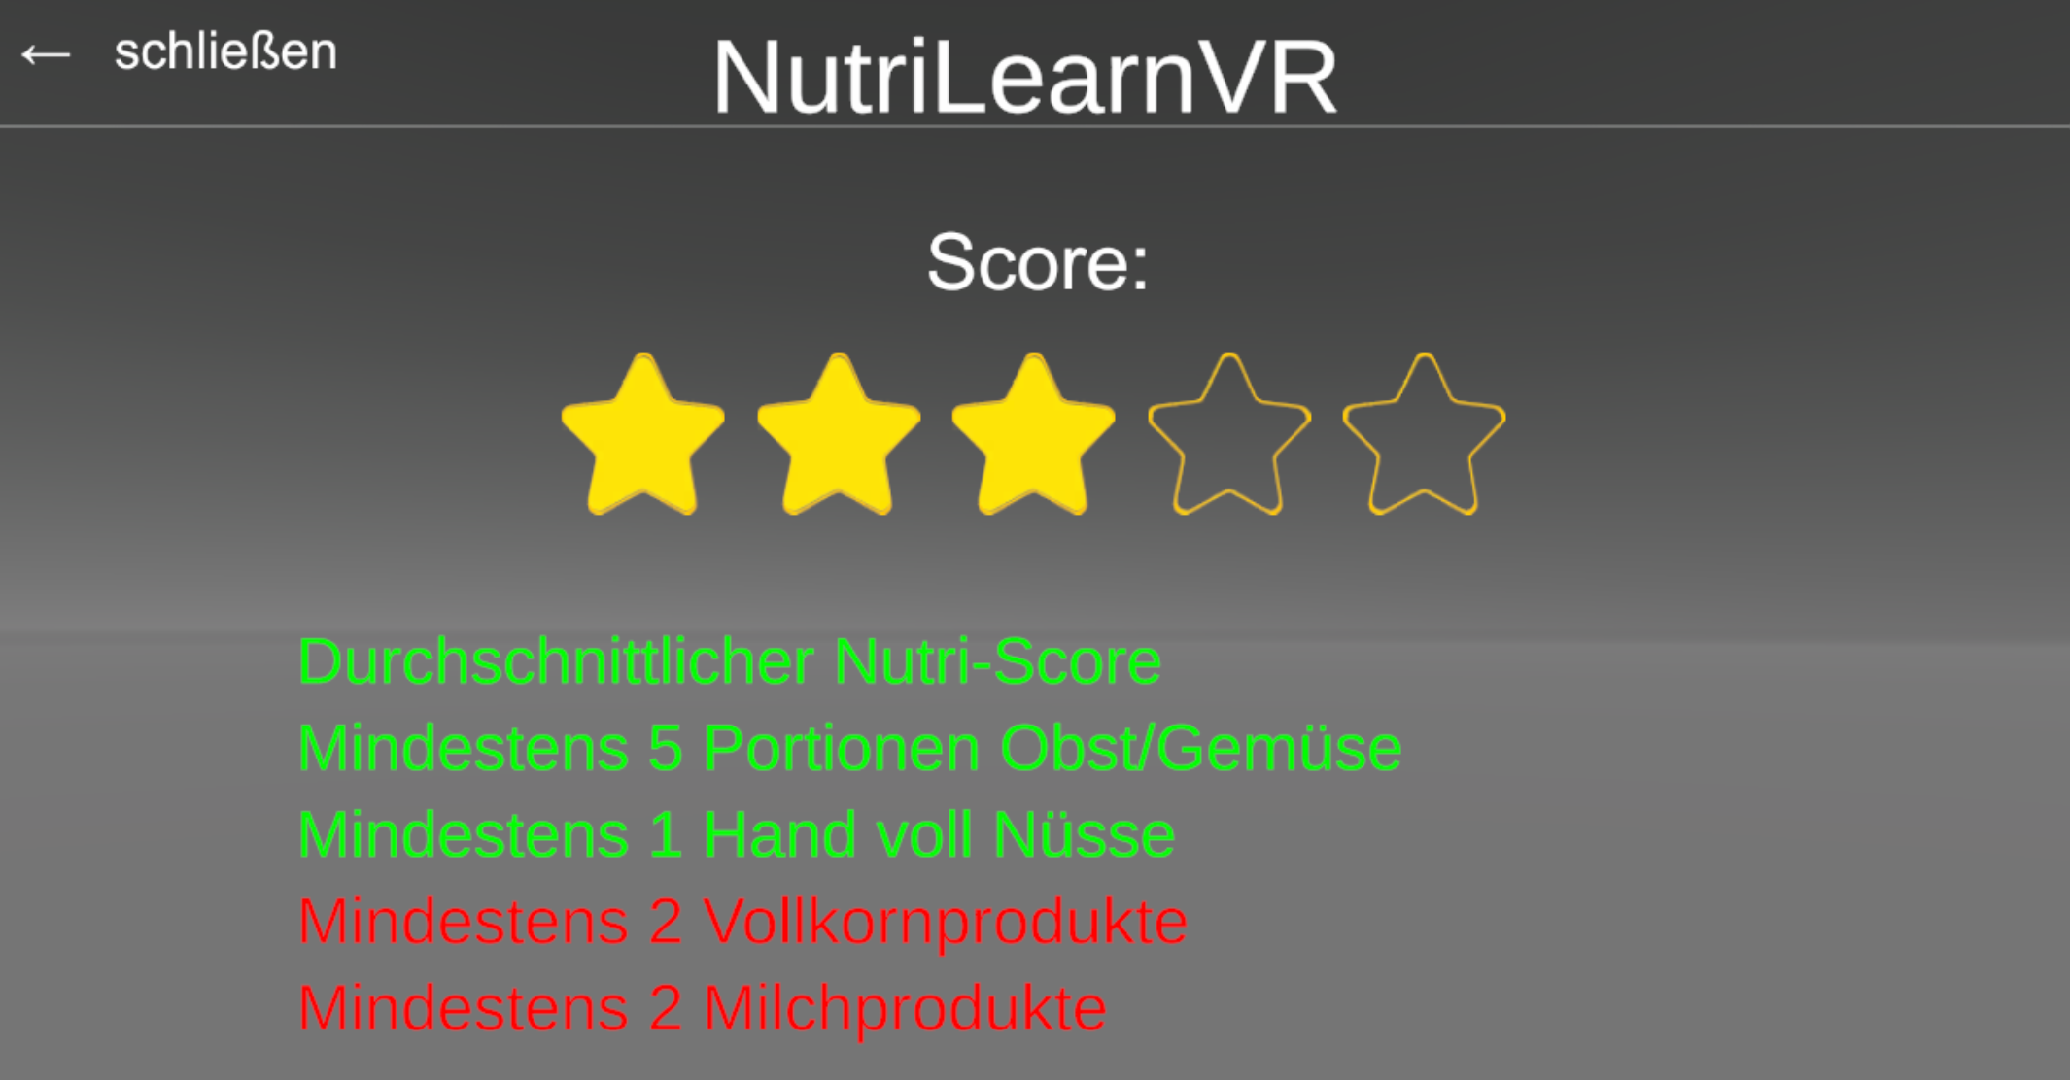
Score Implementation
Notes:
Score displayed to user, using simplified star representation for better understanding.
Further feedback, using colors for additional value

Slide 18
Score Implementation
Based on Healthy Diet Consultation:
Fruits & Vegetables: 5+ Portions
Nuts: at least 1 Portion
Whole Grain Products: 2+ Products
Dairy Products: 2+ Products
„Good“ average Nutri-Score
Other Factors (Nutrient Quality)
If met, +1 Star each
A-B | C | D-E
+1 Star | No Change | -1 Star
Notes:
Score based on the information gained from consultation on healthy diet.
Star score is forced to 0-5 range, no negative score possible.
Additionally awarding stars for meeting category criteria, awarding / possibly deducting star for bad average nutri-score
(13)

Slide 19
Research Objective
Research Question (RQ):
Is an educational VR Application capable of supporting users in a way that they make more conscious decisions regarding their own health in the field of nutrition?
Notes:
From the start of development & based on hoped-for goals of Applications we defined following Research Question

Slide 20
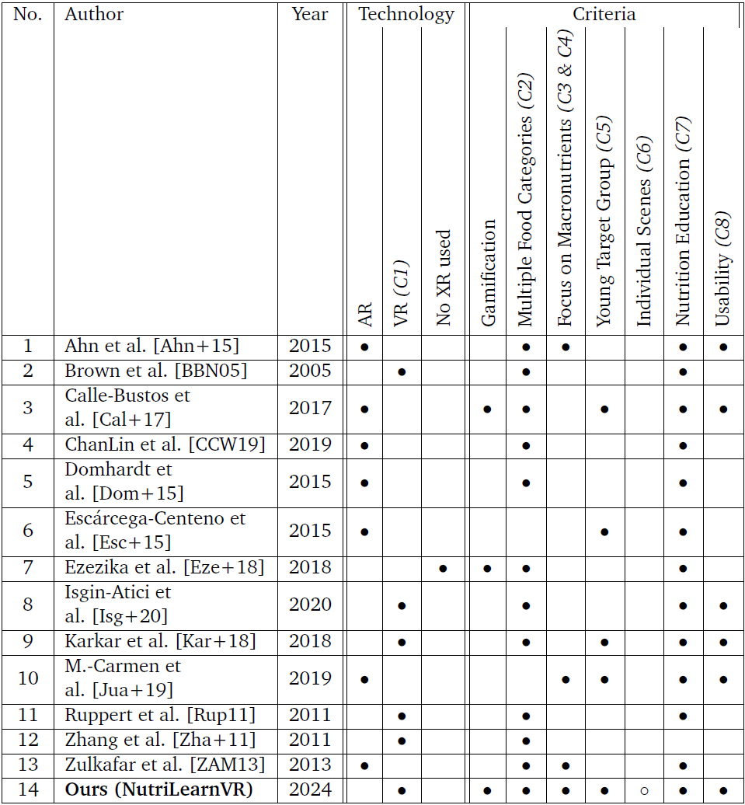
Related Work
Mostly AR focused
Never takes all criteria into account
Notes:
- Ahn et al: AR shopping assistant for healthier shopping, helps finding products
- Brown et al: Nutritional Support for HIV women in VR
- Calle-Bustos et al: Food Volume Estimation for diabetes
- ChanLin et al: AR mobile App for nutrition education
- Domhardt et al: Food Volume Estimation for diabetes
- Escarcega-Centeno et al: Volume Estimation for sweetened beverages in Mexico
- Ezezika et al: Gamification of Nutrition Education in Nigeria
- Isgin-Atici et al: Digitalized Nutrition Education in VR in general
- Karkar et al: Children breakfast in VR, but no macronutrients and gamification and strict focus on breafast scenario
- M.-Carmen et al: AR support to learn about nutrients on packaged foods
- Ruppert et al: Study about Marketing of food products in VR
- Zhang et al: Food Volume Estimation
- Zulkafar et al: Displays Nutritional Information in VR

Slide 21
Research Objective - Hypotheses
(H1) The Learning Environment triggers a learning effect
(H2) Users interact more with food products if more information is given
(H3) The coloring of nutrient information is understandable to the user and influences decisions towards a better selection of food products
(H4) The usability benefits user motivation towards software usage and makes it easier for them to find their way within the system
Notes:
Additionally, we defined these hypotheses to examine in the results.
(15)

Slide 22
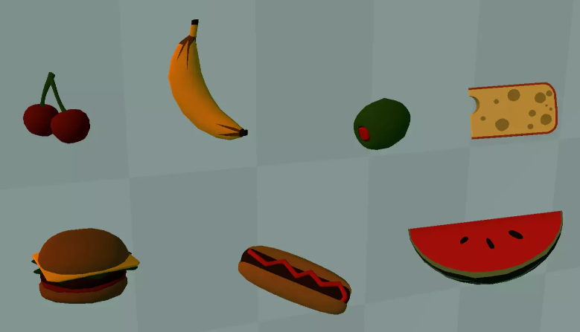
Model Acquisition
Usually Low Poly
Insufficiently realistic
Source: Unity Asset Store [7]
Notes:
Big part and time effort was model acquisition. Initially planned source: Unity Asset Store or other online free databases with realistic 3D representation.
Focus on realistic representation for better connection with reallife food products.

Slide 23
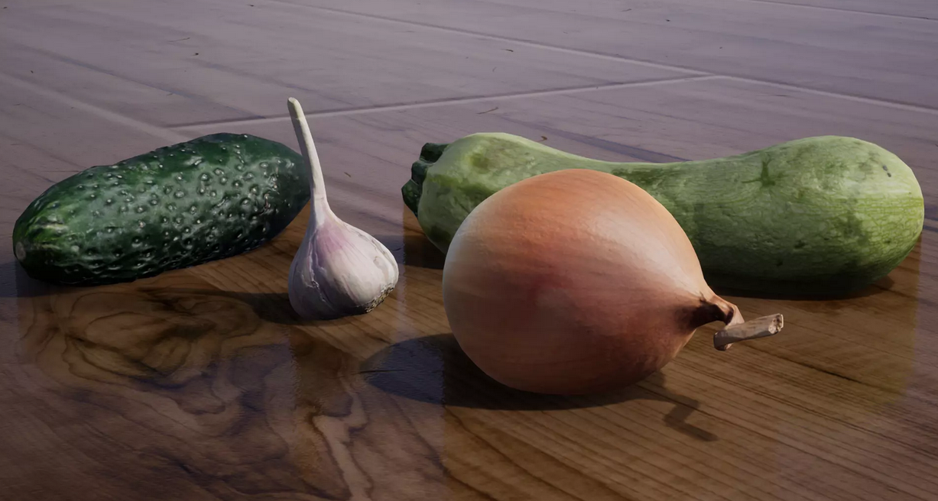
Model Acquisition
Usually Low Poly
Insufficiently realistic
Source: Unity Asset Store [7]
Rarely 3D Scans
Realistic Representation & Size
Better Connection to Real Life
Source: Unity Asset Store [8]
Notes:
3D Scans, especially free are extremely rare. Of the displayed products, only 3 are used.

Slide 24
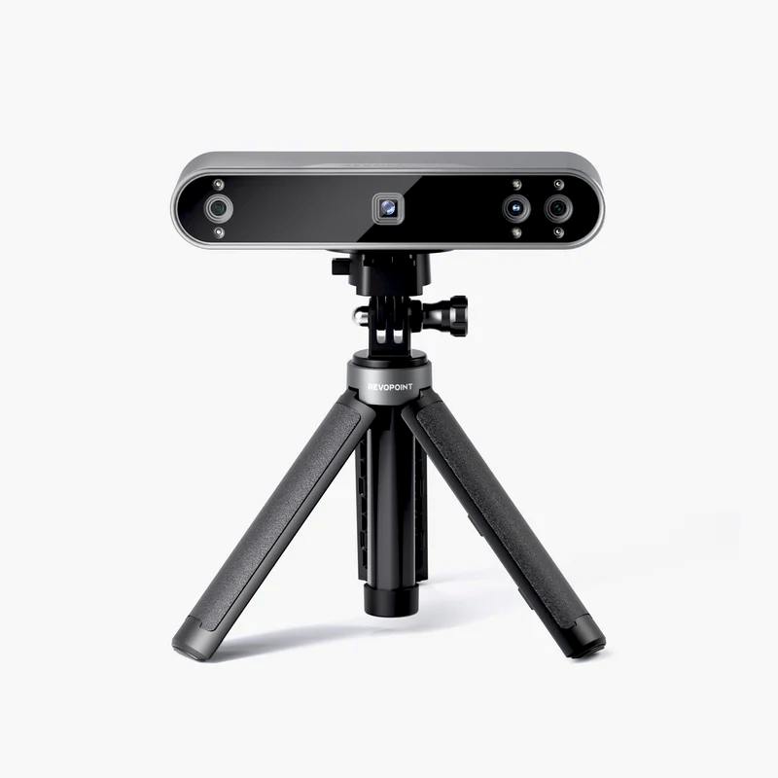
Model Acquisition
Creation of own Models
Revopoint POP 3 3D Scanner
500+ Scans → 65 3D Models used
Self-built Studio
Source: revopoint3d.com [9]
Notes:
Rest of models were created by hand using Scanner provided by University.
Of more than 500 Scans created in a self-built studio, only 65 models were used. Additionally to the 3 mentioned before.

Slide 25
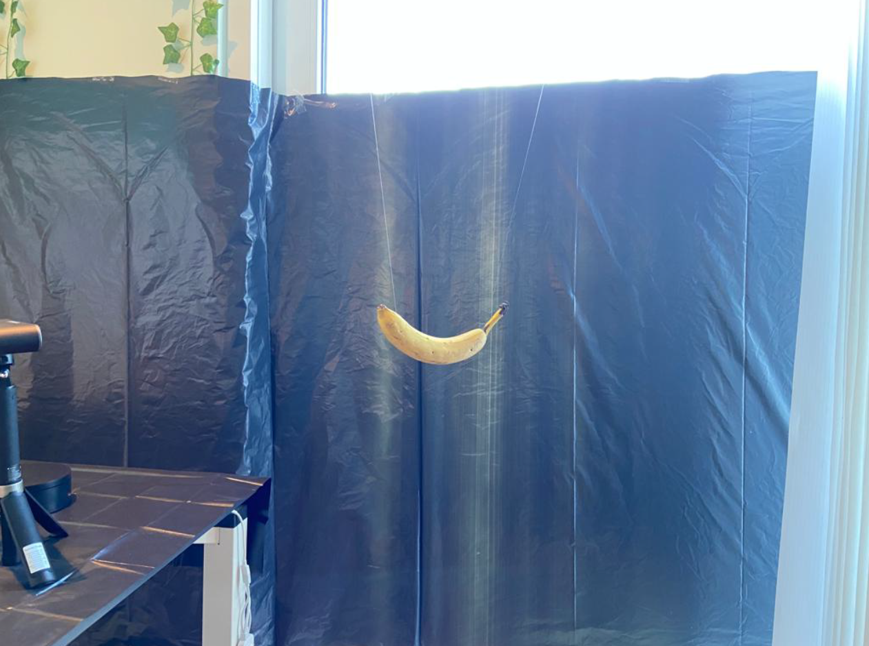
Model Acquisition
Notes:
Scanner on left hand side with turntable for flat objects
Walls, glass covered with black foil
Objects were hanging from hooks in roof using fishing line.
(17)

Slide 26
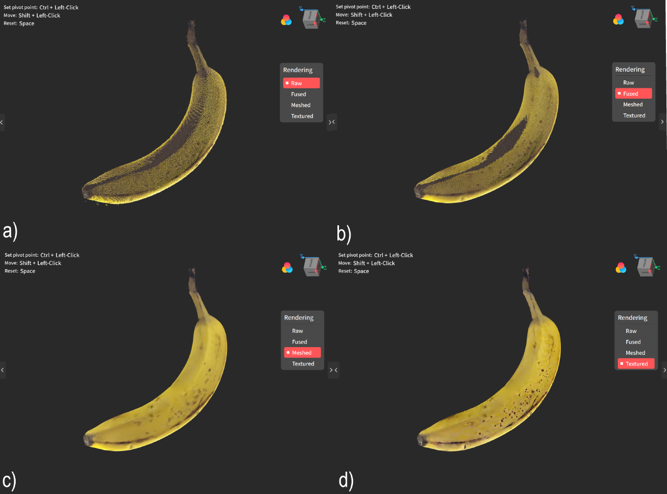
Model Acquisition
Notes:
Scan Post-Processing in RevoScan Software of Scanner.
Further Post-Processing in Blender: Scaling, Position, Rotation, Simplifying

Slide 27
User Study
User Demographics (N = 15):
Notes:
User Study performed at Paderborn University with 15 voluntary individuals, typically slightly older than targeted „young generation“

Slide 28
User Study
User Demographics (N = 15):
Average User:
26.33 years
Approx. 175 cm
Approx. 75 kg
Approx. 2730 kcal/day
Prior Knowledge: 1.13
Notes:
Average User Study Participant information…

Slide 29
User Study
2 different Scenes
Full Scene and Reduced Scene
Random Start Scene
Full Scene:
Display all Information
Color Feedback in Selection UI & Score
Reduced Scene:
Display less Nutrient Information
No Color Feedback
Notes:
User Study was performed in 2 different scenes. Star Scene determined randomly by coin toss..

Slide 30
User Study
Captured Data per Scene:
User Data:
Gender, Age, Height, Weight, avg. Daily Energy Consumption, self-assessed Nutrition Knowledge
Notes:
- User Data was used to derive average daily energy consumption based on body information and physical activity level within the App

Slide 31
User Study
Captured Data per Scene:
User Data:
Gender, Age, Height, Weight, avg. Daily Energy Consumption, self-assessed Nutrition Knowledge
Selection Data:
Sum of Calories, Carbs, Sugar, Protein, Fats & Saturated Fats
Number of Fruits/Vegetables, Nuts, Whole Grain + Dairy Products
Average Nutri-Score of Selection
Achieved Star Score
Notes:
- Selection Data provides general information about food selection in summary.
Contains information about selected food products & score relevant information, e.g. in categories.

Slide 32
User Study
Captured Data per Scene:
User Data:
Gender, Age, Height, Weight, avg. Daily Energy Consumption, self-assessed Nutrition Knowledge
Selection Data:
Sum of Calories, Carbs, Sugar, Protein, Fats & Saturated Fats
Number of Fruits/Vegetables, Nuts, Whole Grain + Dairy Products
Average Nutri-Score of Selection
Achieved Star Score
Item Interaction:
Food Product Name + Category
Interaction Type (Grab, Release, Select, Deselect)
Notes:
- Item Interaction information contains name and category for all food products interacted with and interaction type

Slide 33
User Study
Captured Data per Scene:
User Data:
Gender, Age, Height, Weight, avg. Daily Energy Consumption, self-assessed Nutrition Knowledge
Selection Data:
Sum of Calories, Carbs, Sugar, Protein, Fats & Saturated Fats
Number of Fruits/Vegetables, Nuts, Whole Grain + Dairy Products
Average Nutri-Score of Selection
Achieved Star Score
Item Interaction:
Food Product Name + Category
Interaction Type (Grab, Release, Select, Deselect)
Time Stamps for all Interactions (+other Data)
Notes:
All Interactions and other data have time stamps for computing the interaction time with different objects

Slide 34
User Study
Captured Data per Scene:
User Data:
Gender, Age, Height, Weight, avg. Daily Energy Consumption, self-assessed Nutrition Knowledge
Selection Data:
Sum of Calories, Carbs, Sugar, Protein, Fats & Saturated Fats
Number of Fruits/Vegetables, Nuts, Whole Grain + Dairy Products
Average Nutri-Score of Selection
Achieved Star Score
Item Interaction:
Food Product Name + Category
Interaction Type (Grab, Release, Select, Deselect)
Time Stamps for all Interactions
SUS Score Questionnaire
Notes:
Finally, SUS Score Questionnaire was handed in preferred language (English, German) to assess SUS Score.
(21)

Slide 35
Results – Scene Change
(H1) The Learning Environment triggers a learning effect
Criterion | Full → Reduced Scene | Reduced → Full Scene
Energy Level | 198.5 kcal (0.089) | 425.5 kcal (0.165)
Carbohydrates | 3.26 g (-0.037) | 72.96 g (0.052)
Sugar | 21.66 g (0.037) | 6.8 g (-0.004)
Protein | 21.38 g (0.028) | 35.18 g (0.012)
Fats | 13.14 g (0.026) | -3.52 g (-0.061)
Saturated Fats | 6.01 g (0.012) | 3.08 g (-0.019)
#Fruits/Vegetables | 1.2 | 1.8
#Nuts | 0.1 | 0
#Whole Grain | -0.3 | 3.2
#Dairy Products | 0.9 | -0.4
Average Nutri-Score Value | 1.778 | -4.460
Achieved Star Score | 0.5 | 0.8
Notes:
Regarding (H1), the learning effects triggered by the learning environment, we can observe the changes to the user selection between scenes.

Slide 36
Results – Scene Change
(H1) The Learning Environment triggers a learning effect
Criterion | Full → Reduced Scene | Reduced → Full Scene
Energy Level | 198.5 kcal (0.089) | 425.5 kcal (0.165)
Carbohydrates | 3.26 g (-0.037) | 72.96 g (0.052)
Sugar | 21.66 g (0.037) | 6.8 g (-0.004)
Protein | 21.38 g (0.028) | 35.18 g (0.012)
Fats | 13.14 g (0.026) | -3.52 g (-0.061)
Saturated Fats | 6.01 g (0.012) | 3.08 g (-0.019)
#Fruits/Vegetables | 1.2 | 1.8
#Nuts | 0.1 | 0
#Whole Grain | -0.3 | 3.2
#Dairy Products | 0.9 | -0.4
Average Nutri-Score Value | 1.778 | -4.460
Achieved Star Score | 0.5 | 0.8
Notes:
Within Categories, we can see plenty of changes but no clear trends. We observe that besides all changes the star score increase.
Due to challenging nature of score definition this is no clear sign for a learning effect.
→ No CLEAR learning effect can be measured in the short-term experiment. Learning Effect can be regarded as long-term effect that cannot be measured in the time frame of a master‘s thesis.

Slide 37
Results - Scene Comparison
Criterion | Full Scene | Reduced Scene
Energy Level | 2200.533 kcal (0.810) | 2191.133 kcal (0.815)
Carbohydrates | 216.900 g (0.411) | 194.753 g (0.369)
Sugar | 80.440 g (0.150) | 92.613 g (0.175)
Protein | 107.227 g (0.184) | 109.753 g (0.199)
Fats | 85.867 g (0.340) | 95.800 g (0.378)
Saturated Fats | 28.14 g (0.105) | 31.12 g (0.120)
#Fruits/Vegetables | 6.067 | 6.267
#Nuts | 1.2 | 1.267
#Whole Grain | 2.6 | 1.333
#Dairy Products | 1.8 | 2.533
Average Nutri-Score Value | 1.754 | 4.426
Achieved Star Score | 3 | 3.067
Notes:
Direct comparison of both scenes shows that users expectedly select less calories than personal average daily energy level (limited Provision of food products). Better Quality in Full Scene.

Slide 38
Results – Scene Change
(H3) Coloring is understandable & influences Decisions towards better Selection
Criterion | Full → Reduced Scene | Reduced → Full Scene
Energy Level | 198.5 kcal (0.089) | 425.5 kcal (0.165)
Carbohydrates | 3.26 g (-0.037) | 72.96 g (0.052)
Sugar | 21.66 g (0.037) | 6.8 g (-0.004)
Protein | 21.38 g (0.028) | 35.18 g (0.012)
Fats | 13.14 g (0.026) | -3.52 g (-0.061)
Saturated Fats | 6.01 g (0.012) | 3.08 g (-0.019)
#Fruits/Vegetables | 1.2 | 1.8
#Nuts | 0.1 | 0
#Whole Grain | -0.3 | 3.2
#Dairy Products | 0.9 | -0.4
Average Nutri-Score Value | 1.778 | -4.460
Achieved Star Score | 0.5 | 0.8
Notes:
Regarding (H3): Understanding and Influence of coloring on user decisions → slightly better quality of macronutrients in Full Scene.
Remarkably better meet of energy level and sugar decrease even though carbohydrates increase. Smaller proportion (saturated) fats.
(24)

Slide 39
Results – Product Interaction
(H2) More Nutrient Information → More Interaction
Full Scene
Reduced Scene
Category | #Products | #hold | #release | #select | #deselect | #hold | #release | #select | #deselect
Fruits/Vegetables | 20 | 195 | 69 | 119 | 7 | 160 | 51 | 106 | 3
Nuts/Legumes | 6 | 62 | 38 | 21 | 3 | 39 | 20 | 19 | 0
Whole Grain | 6 | 97 | 42 | 52 | 3 | 54 | 21 | 32 | 1
Animal Products | 9 | 112 | 57 | 50 | 5 | 95 | 45 | 49 | 1
Dairy Products | 5 | 64 | 32 | 29 | 3 | 63 | 25 | 38 | 1
Bakery Products | 6 | 83 | 52 | 28 | 3 | 63 | 31 | 31 | 1
Prepared Dishes | 6 | 56 | 44 | 11 | 1 | 29 | 17 | 11 | 1
Miscellaneous | 10 | 118 | 61 | 56 | 1 | 88 | 38 | 49 | 1
Notes:
Besides two values for Selection in Reduced Scene, we always record more interactions in the Full Scene. Among all categories of food products.

Slide 40
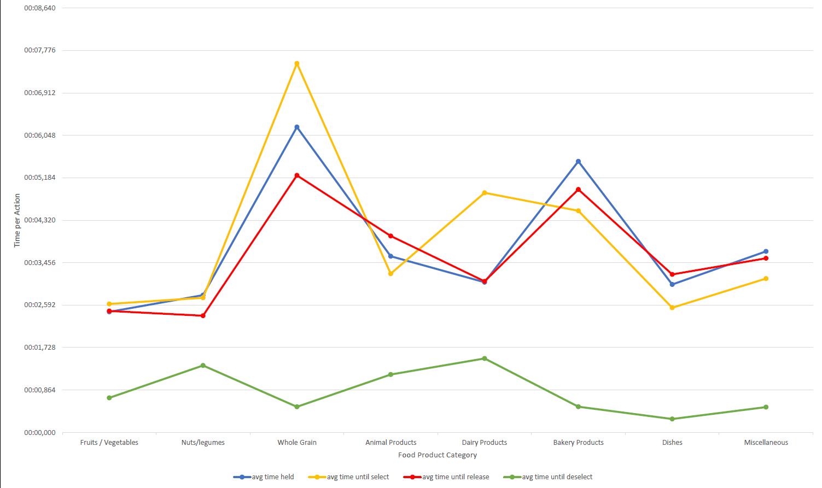
Product Interaction – Full Scene
Notes:
In general, users took noticeably more timei in full scene
Whole Grain Products were interacted with the longest, but second shortest deselection time.

Slide 41
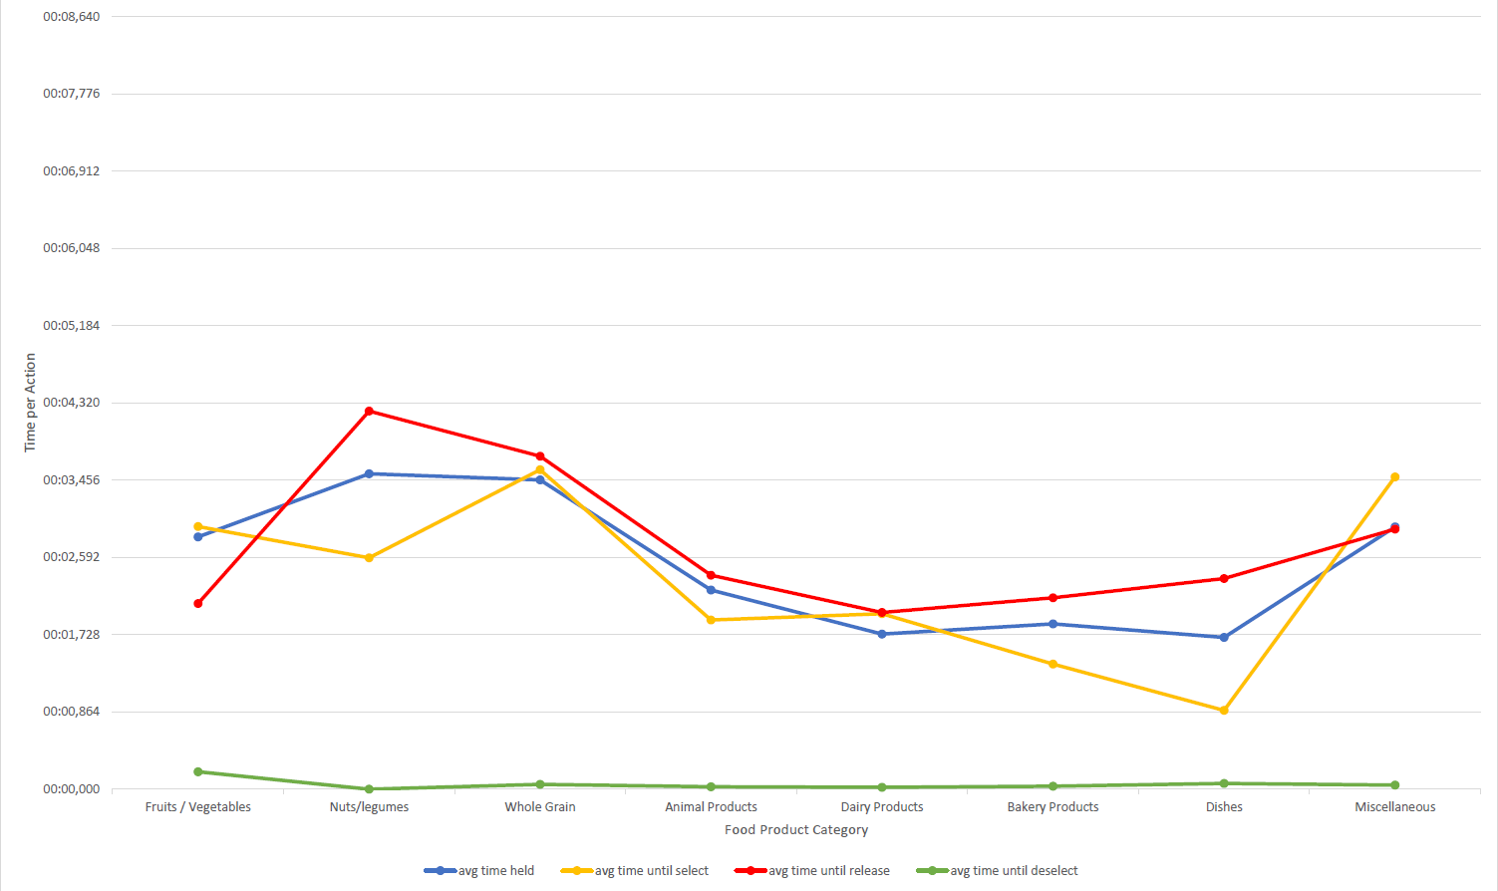
Product Interaction – Reduced Scene
Notes:
Nuts/Legumes and Whole Grain Products were interacted with the longest.

Slide 42
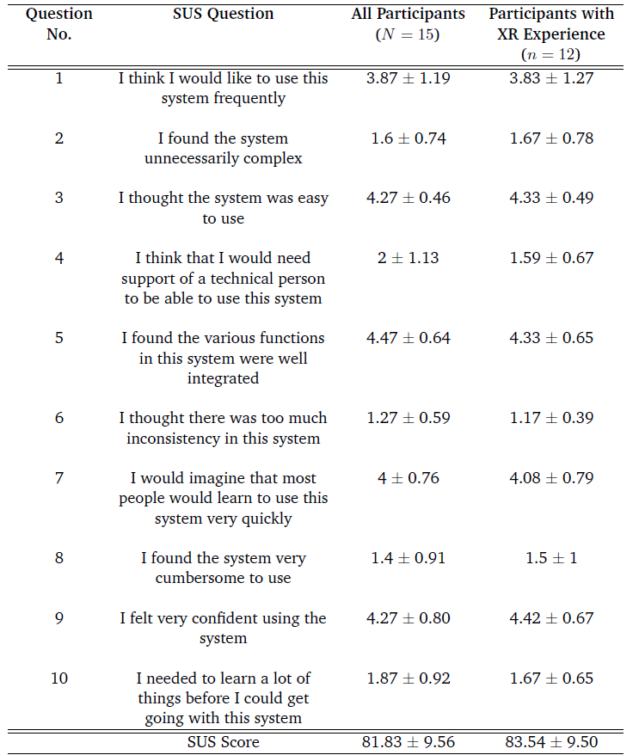
Results – SUS Score
(H4) Usability benefits User Motivation towards Software Usage
Notes:
For (H4) and User Motivation benefits from Usability we check SUS Score Questionnaires. Average values and standard deviations displayed for all 10 questions typically being part.

Slide 43
Results – SUS Score
(H4) Usability benefits User Motivation towards Software Usage
Notes:
Question 1 meets the criteria of hypothesis best. Users show interest and are accepting the system. Willing to use the system more frequently in the future.

Slide 44
Results – SUS Score
(H4) Usability benefits User Motivation towards Software Usage
„Professional Implementation“
„High Implementation Quality“
Notes:
Paired with statements from User Test this further increases this impression, proves that focus on Usability pays off.

Slide 45
Results – SUS Score
90th Percentile [11]
Notes:
Differentiation between all and users with prior experience shows that system is more understandable and better interactable for experienced users.
Also increases overall SUS Score a bit.
Proud of Final Score, being in 90th percentile, exceptionally good base for further development in future.

Slide 46
Discussion
Research Question (RQ):
→ NO real Learning Effect provable, BUT better Quality decisions while Usage!
Is an educational VR Application capable of supporting users in a way that they make more conscious decisions regarding their own health in the field of nutrition?
Notes:
(27) Referring back to RQ from start we observe…
… However, one must consider that..

Slide 47
Discussion
No long-term Study for long-term Effects!
Limited Choice of Food Products
Challenge: Application Design
Nutrition too individual & complex
Too many Differences between singular days
→ Gamification: Score-System error-prone!
Notes:
Not able to perform long-term study for measuring any long-term effects → preferred for educational application field.
Limited Choice of Food Products can influence user actions & manipulate results
We observe the application design as a general challenge that needs extensive planning. The main problem is the underlying topic being very individual and complex and too many differences and variables when comparing singular days.
Regarding Gamification, the design of a score-system is error-prone and other options may be more advisable, even though feedback is reduced a lot.

Slide 48
Conclusion
NutriLearnVR provides educational platform that helps Users in more conscious decisions
Display & Coloring of Information useful
Notably good SUS Score
No long-term effects could be measured
Provision of Application, prepared Database & 65 self-scanned 3D Models
Notes:
To conclude the presented results we can say that…

Slide 49
Future Work
Long-term study
More Gamification Elements
Implementation of „Challenges“
Revision of Score-System
Implementation of additional Scenes
Further Individualizations
Allergens
Consumption Preferences
Notes:
Regarding future work…

Slide 50

Question & Answer
Notes:
Thank you for your attention up until this point. Finally time for Question & Answer session.

Slide 51
Sources
[1] https://www.hna.de/verbraucher/supermarkt-rewe-edeka-verbraucher-news-beste-supermaerkte-deutschland-supermarkt-einkaufen-92283033.html
[2] Pavel Smutny, Marek Babiuch, and Petr Foltynek. „A Review of the Virtual Reality Applications in Education and Training“. In: 2019 20th International Carpathian Control Conference (ICCC). May 2019, pp. 1–4
[3] Deutsche Gesellschaft fur Ernahrung e.V. „Vollwertig essen und trinken nach den 10 Regeln der DGE“. In: Deutsche Gesellschaft fur Ernahrung e.V. - FAQ gesunde Ernahrung (2017)
[4] Fred Brouns. „Whole Grain- Health- Scientific Consensus-ICQC 2017“. In: Sept. 2017, pp. 1–12
[5] Dariush Mozaffarian. „Dairy Foods, Obesity, and Metabolic Health: The Role of the Food Matrix Compared with Single Nutrients“. In: Advances in nutrition (Bethesda, Md.) 10 (Sept. 2019), 917S–923S
[6] Serge Hercberg, Mathilde Touvier, and Jordi Salas-Salvado. „The Nutri-Score nutrition label“. In: International journal for vitamin and nutrition research. Internationale Zeitschrift fur Vitamin- und Ernahrungsforschung. Journal international de vitaminologie et de nutrition 92.3-4 (July 2022), pp. 147–157
[7] https://assetstore.unity.com/packages/3d/food-props-163295
[8] https://assetstore.unity.com/packages/3d/props/food/free-4k-scanned-vegetables-minipack-135434
Notes:
Sources to papers and images used for preparing this presentation. Further overview about details can be taken from the master‘s thesis‘ bibliography.

Slide 52
Sources
[9] https://www.revopoint3d.com/products/portable-3d-scanner-pop3
[10] Bundesamt fur Lebensmittelsicherheit und Veterinarwesen. Schweizer Nahrwertdatenbank. 2023. URL: https://naehrwertdaten.ch/
[11] PhD Jeff Sauro. 5Ways to Intrepret a SUS Score. 2018. URL: https://measuringu.com/interpret-sus-score/

